Slide 1


2021 AWS Security AOD Artifacts
IoT device metrics and logs monitoring and visualization
Yang Yang
login yyangna
GCR IoT Consultant
Dec, 2021
© 2020, Amazon Web Services, Inc. or its Affiliates. All rights reserved.

Slide 2
Background
IoT Security information
Important insight from different log resources for device security and monitoring
Customer pay less attention to these logs because of less user friendly methods
No real-time notification mechanism when security issue happen
Device generated logs
Amazon IoT Core logs
AWS IoT Device Defender audit logs
……
Real-time
Visualization

Slide 3
IoT Security information
Device generated logs
[2021-05-16T10:54:26.319Z][DEBUG]-Routed message. { "subject": "hello/world", "src": "arn:aws-cn:lambda:cn-north-1:502454306654:function:ChinaDemo:1", "destinations": "cloud"}
Information generated from local device which indicate what happen in device side.

Slide 4

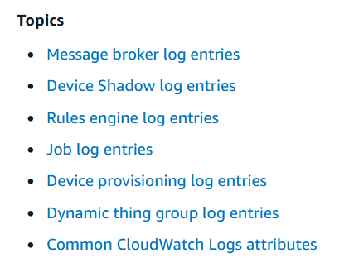
IoT Security information
Amazon IoT Core logs
{ "timestamp": "2021-12-10 06:21:29.936", "logLevel": "INFO", "traceId": "647e5701-b0d0-eab0-fde5-dd6b6eccaeab", "accountId": "502454306654", "status": "Success", "eventType": "Publish-In", "protocol": "MQTT", "topicName": "$aws/sitewise/gateways/MyGreengrassCore3/diagnostics", "clientId": "MyGreengrassCore3", "principalId": "f95cdfb74a62e263b38131fd5819000c1ffe31164fad866c196795f9a9740377", "sourceIp": "52.81.34.199", "sourcePort": 48910 }
Information generated from Amazon IoT Core which indicate what happen in cloud side.

Slide 5
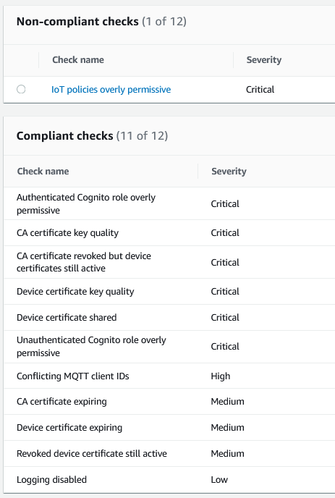
IoT Security information
AWS IoT Device Defender audit logs
CloudWatch Metric integrated
Daily audit!

Slide 6









Architecture
Amazon IoT Core logs
Device generated logs
AWS Secrets Manager
Amazon Simple Storage Service (S3)
AWS loT Core
Devices
Amazon CloudWatch
AWS Lambda
Amazon Elasticsearch Service
AWS loT Device Defender
Amazon Simple
Notification Service
AWS IoT Device Defender audit logs

Slide 7
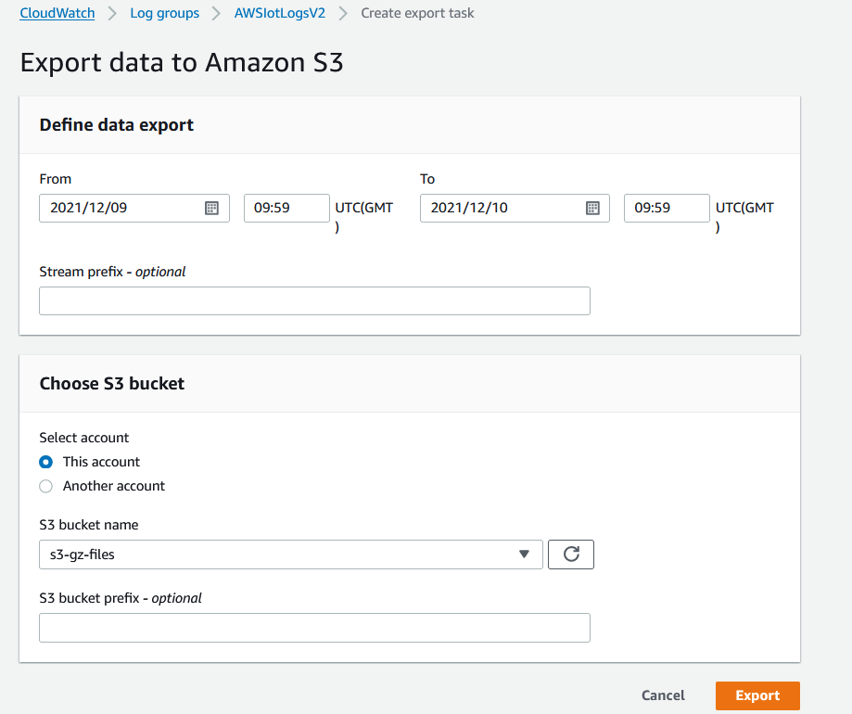
Amazon IoT Core logs
Use native export function from cloudwatch console to export group logs into S3 bucket
.gz
s3-gz-files
Get Opensearch credentials
AWS Lambda
AWS Secrets Manager
index = 'lambda-s3-index'
Amazon Elasticsearch Service

Slide 8
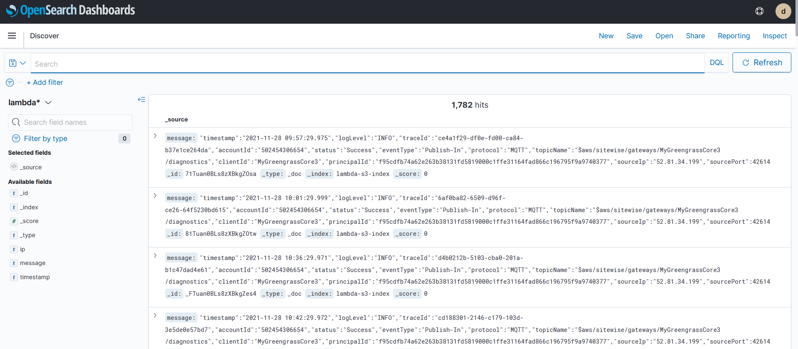
Amazon IoT Core logs
1782 hits for all kinds of IoT logs

Slide 9
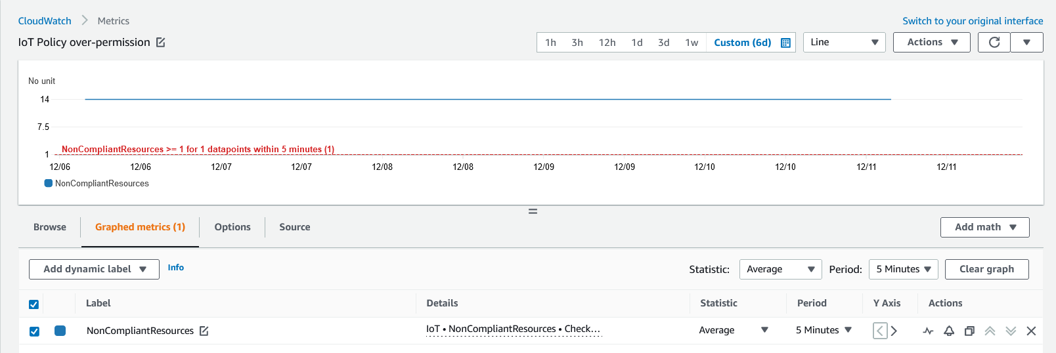
IoT Core and Device Defender metrics in CloudWatch
IoT policies overly permissive
Amazon CloudWatch
Amazon Simple
Notification Service
AWS Lambda
Amazon Elasticsearch Service
Rule : Average datapoints >= 1 within 5 mins
Metric
AWS Secrets Manager

Slide 10
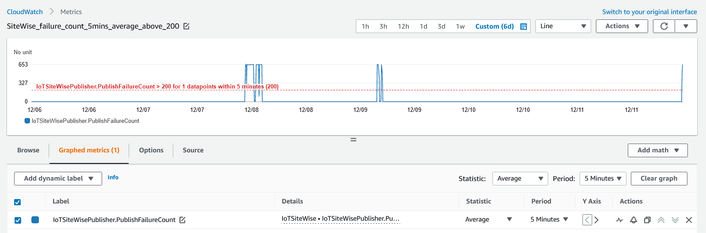
IoT Core and Device Defender metrics in CloudWatch
SiteWise_failure_count_5mins_average_above_200
Amazon CloudWatch
Amazon Simple
Notification Service
AWS Lambda
Amazon Elasticsearch Service
Rule : Average datapoints >= 200 within 5 mins
Metric
AWS Secrets Manager

Slide 11
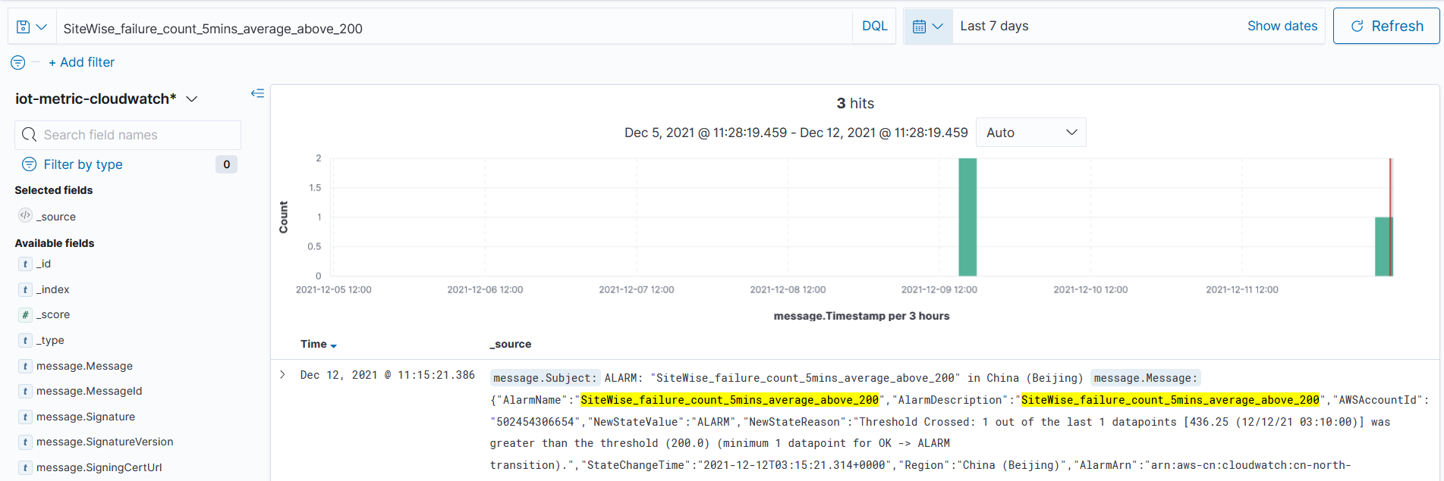
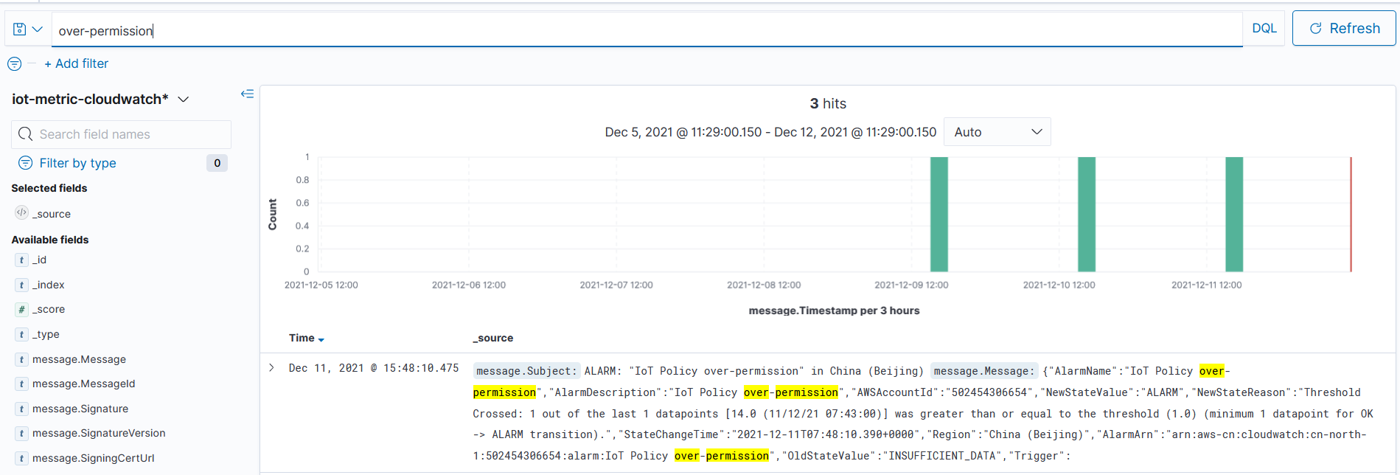
IoT Core and Device Defender metrics in CloudWatch
SiteWise_failure_count_5mins_average_above_200
IoT policies overly permissive

Slide 12
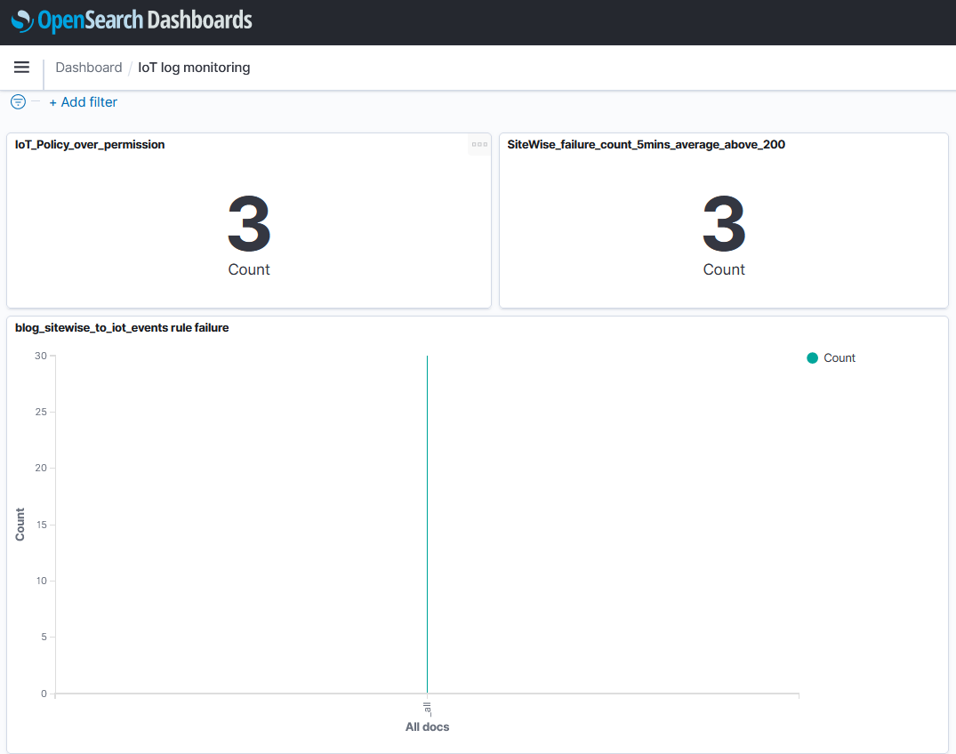
OpenSearch Dashboard
3 dashboard widgets

Slide 13

Summary
Main IoT log and security related information monitoring and visualization
Real-time monitoring to find issue in time
User friendly view with OpenSearch dashboard to check the status anytime and anywhere
Use AWS OpenSearch service to filter any log and security information attribute

Slide 14
Thank you! - Q&A

